Slide 1


Network protocols & security
24EC2210
Topic:
vlans
Session – 13

Slide 2



AIM OF THE SESSION
To familiarize students with the different networking and internetworking devices
INSTRUCTIONAL OBJECTIVES
This Session is designed to:
Explain the concept and purpose of Virtual Local Area Networks (VLANs) in network architecture.
Demonstrate VLAN configuration and implementation on network devices.
LEARNING OUTCOMES
At the end of this session, you should be able to:
Explain the concept and significance of VLANs in network architecture.
Create and configure VLANs on network devices using appropriate methodologies.
Understand the role of VLAN trunking protocols in interconnecting VLANs.

Slide 3
AGENDA
Virtual Local Area Network (VLAN)
Benefits of Switched Network
Benefits of VLAN
Types of Ports in VLAN
Frame Tagging

Slide 4
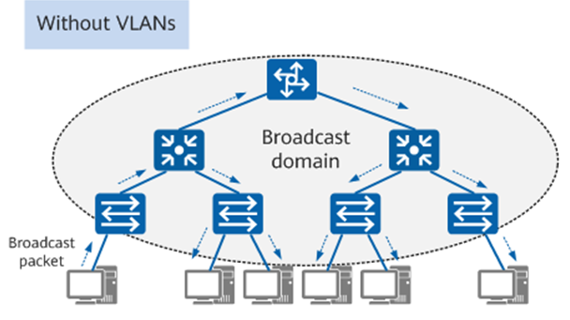
Virtual local area network (VLAN)
A LAN is a group of devices connected to a single Ethernet network.
A broadcast message is a message that reaches all devices in the network.
Devices use broadcast messages to perform many essential tasks.
The more devices you add to a network, the more broadcast messages it will have which in turn reduce network performance.

Slide 5
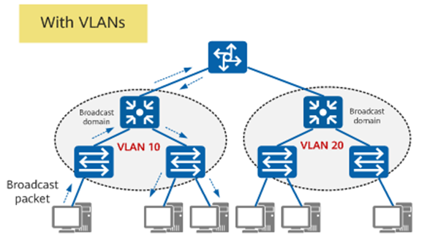
Virtual local area network (VLAN)
To improve network performance, VLANs are used which create a boundary for broadcast messages.
A VLAN (Virtual Local Area Network) is a logical network construct that allows the segmentation of a physical network into multiple virtual networks.
In a VLAN, the computers, servers, and other network devices are logically connected regardless of their physical location.
It is created by grouping devices together based on factors such as department, function, or security requirements.

Slide 6
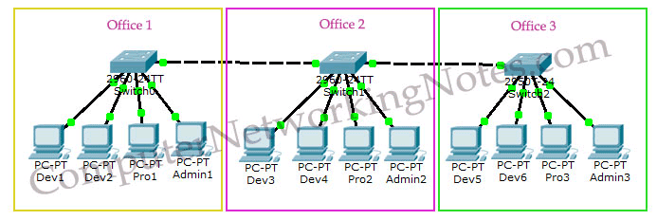
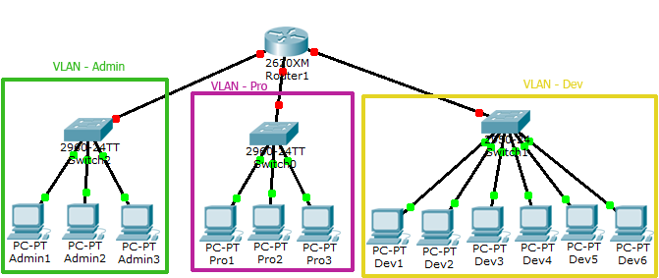

Slide 7
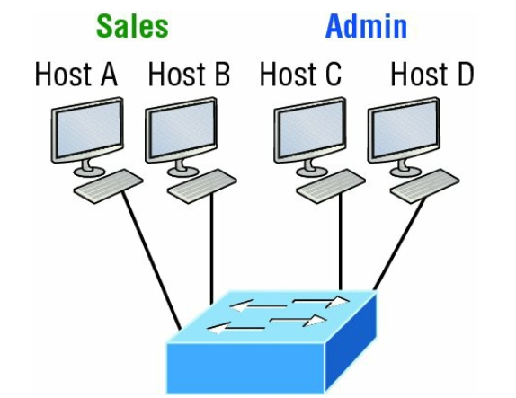
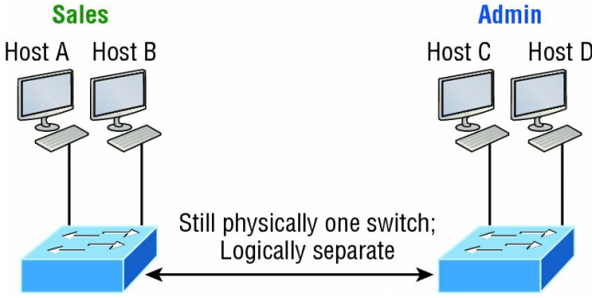
example
One switch, one LAN: Before VLANs, there were no separations between hosts
One switch, two virtual LANs (logical separation between hosts): Still physically one switch, but this switch acts as many separate devices.

Slide 8
Benefits of VLANs
Enhanced Network Security: VLANs allow for logical segmentation of a network, enabling administrators to isolate sensitive data or systems from unauthorized access.
Improved Network Performance: VLANs help reduce network congestion by limiting broadcast traffic.
Simplified Network Management: VLANs provide administrative flexibility by allowing network administrators to manage logical groups of devices based on their function or location.
Scalability and Flexibility: VLANs enable network scalability by accommodating the addition of new devices or users without the need to reconfigure the entire network infrastructure.
Improved Resource Sharing: VLANs facilitate effective resource sharing within specific groups or departments without the need for routing.

Slide 9
Benefits of VLANs contd…
Guest Network Isolation: VLANs allow for the creation of separate guest networks, which are isolated from the main network.
Efficient Troubleshooting: VLANs simplify troubleshooting by isolating network issues to specific VLANs.
Quality of Service (QoS) Optimization: VLANs can be used to prioritize network traffic by assigning different QoS policies to specific VLANs.
Easy Virtualization Support: VLANs are widely used in virtualized environments, where virtual machines (VMs) can be associated with specific VLANs.

Slide 10
TYPES OF PORTS IN VLAN
There are two different types of ports in a switched environment.
Access Ports
Trunk Ports.
Access Ports
Access port is a connection on a switch that transmits data to and from a specific VLAN.
It is used to connect switches to host devices such as desktops, laptops, printers etc., only available in access link.
It sends and receives Ethernet frames in untagged form from access VLAN.
It can only be member of single VLAN.
Access-link devices can’t communicate with devices outside their VLAN unless the packet is routed

Slide 11
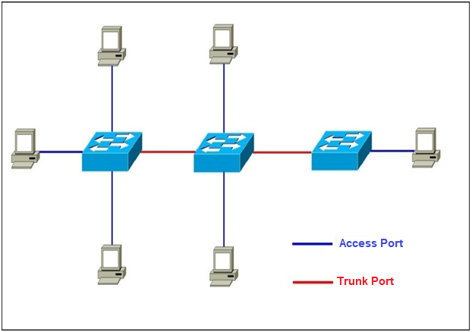
TYPES OF PORTS IN VLAN contd…
Trunk Ports
Trunk port is a connection on a switch that transmits data to and from multiple VLANs.
It is used to connect switches to other switches, routers and servers available in trunk link.
Frames are marked with unique identifying tags when they move between switches so that they can be directed to their designated VLANs.
It can manage traffic for numerous VLANs at the same time.

Slide 12
Frame Tagging
Frame tagging is used to identify the VLAN that the frame belongs to in a network with multiple VLANs.
The VLAN ID is placed on the frame when it reaches a switch from an access port.
That frame can then be forwarded out the trunk link port.
Each switch can see what VLAN the frame belongs to and can forward the frame to corresponding VLAN access ports or to another VLAN trunk port.
Two Trunking protocols are usually used today for frame tagging:
Inter-Switch Link (ISL) – Cisco’s proprietary VLAN tagging protocol.
IEEE 802.1Q – IEEE’s VLAN tagging protocol.

Slide 13
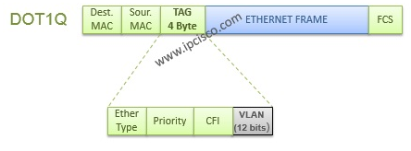
IEEE 802.1Q Frame Tagging:
Dot1Q (IEEE 802.1Q) is the industry standard VLAN Tagging Protocol. So, with this frame tagging protocol, you can trunk different vendors’ switches each other.
Dot1Q modifies the layer-2 header and add 4-byte VLAN tag into it. Because of this process, the frame CRC value is calculated again.
The VLAN tag contains information such as the VLAN ID (VID), priority, and a few control bits.
The VID is a 12-bit field that represents the VLAN to which the frame belongs.
Dot1.q support 4096 VLANs on a trunk.
We can configure Dot1.Q on Cisco switches with the help of “switchport trunk encapsulation dot1.q” command.

Slide 14
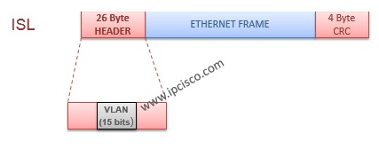
Frame Tagging
2. ISL (Inter-Switch Link) Frame Tagging:
ISL (Inter-Switch Link) is a Cisco proprietary frame tagging protocol and it is not supported on new Cisco devices.
ISL encapsulates the frame with a header (26 bytes) and a trailer (4 bytes). So, ISL increases the size of a frame 30 bytes.
ISL support 1000 VLANs on a trunk port.
We can configure ISL on Cisco switches with the help of “switchport trunk encapsulation isl” command.

Slide 15
SELF-ASSESSMENT QUESTIONS
What is a VLAN (Virtual Local Area Network), and what is its purpose in network infrastructure?
Describe the benefits of implementing VLANs in a network environment.
How does VLAN tagging work, and why is it necessary for inter-switch communication?
Explain the difference between access ports and trunk ports in relation to VLANs.
What are the common methods for VLAN membership assignment on a switch port?
How does VLAN segmentation enhance network security and isolate network traffic?

Slide 16
REFERENCES FOR FURTHER LEARNING OF THE SESSION
Reference Books:
1. Data Communications and Networking, Behrouz A. Forouzan, 4th Edition, McGraw Hill.
2. Computer Networks, Tanenbaum, 6th Edition, Pearson.
Sites and Web links:
CISCO Academy
NPTEL, Computer Networks and Internet Protocols, Prof. Soumya Kanti Ghosh, Prof. Sandip Chakraborty IIT Kharagpur. (https://nptel.ac.in/courses/106105183)

Slide 17
THANK YOU
Team – Networks Protocols & Security

